Slide 1

MOVIE
MINGLE
BY HARISH KUMAR SHARMA

Slide 2
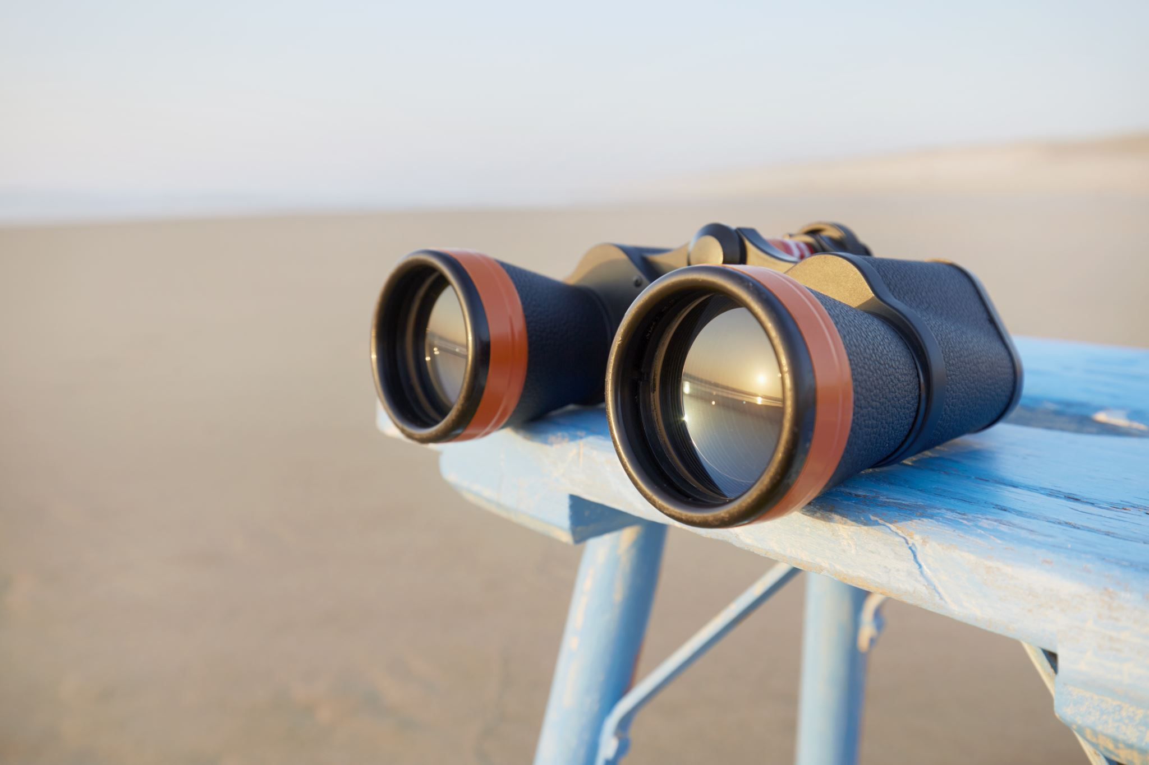
TEAM MEMBERS
1 - HARISH KUMAR SHARMA
(2200290140062)

Slide 3
INTRODUCTION
This Project is related to understand and provide all the movies, web series, and other entertainment sources as per the user mood, The motive to build this project is to connect with AI and Machine Learning to learn with more experience.

Slide 4
TECHNOLOGY USED
-HTML
-CSS
-BOOTSTRAP
-JAVASCRIPT
-PYTHON

Slide 5
HARDWARE USED
-i3 processor 64bit
-16 gb ram

Slide 6
CONCLUSION
I would like to conclude that this project maintains video data .The project has to be upgrade from its current version 1 to version 2.
Version 2 will be considered as a well designed user interface where as its backend code considered as developing with Python, AI, ML.

Slide 7
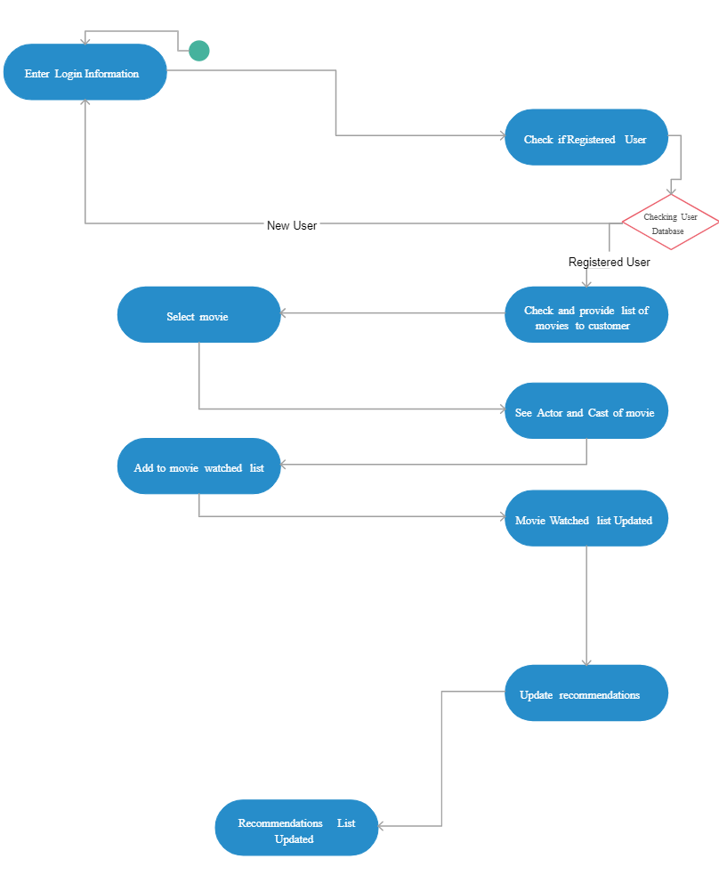
GANTT CHART

Slide 8
Thankyou
- HARISH KUMAR SHARMA

